Slide 1
SAP BTP RAP Training
Day 21
Anubhav Oberoy
www.AnubhavTrainings.com
Follow excellence with sheer passion

Slide 2


DISCLAIMER
The training content and delivery of this presentation is confidential, and cannot be recorded, or copied and distributed to any third party, without the written consent of Anubhav Trainings

Slide 3
Agenda – Day 21
01
Create Projection Layer
02
Service Definition and Binding
03
Create MDE

Slide 4




Business use case
We will implementing 2 different applications on travel data model. These applications will target different user groups. We will manage the travel requests and booking through our applications which are booked by agency for customer.
Processor – a processor is an employee of our company who will request a new travel plan through the application. He/she will be allowed to create, update, delete, copy travel requests including bookings and supplements. They have full control to manage their travel.
Approver – an approver is a manager who will only be able to view the travel requests created by employees, and can only change the booking fees and approval status of the request (approve/reject).
MakeMyTrip.com- processor app
Processor needs to create, update, delete a travel request through agency including all bookings and supplements
Approval App
The manager would review the travel requests created by processor, can only change the booking fees and approve or reject the travel request
www.anubhavtrainings.com

Slide 5
Understanding projection
If we ever get requirement in our company to develop a use case where we want to reuse the data model (e.g. sales, purchase, accounting, finance) but develop many applications. We will go with RAP and projections. A projection takes part of the base functionality according the needs to user. This will reduce effort, increase reusability in our app.
www.anubhavtrainings.com

Slide 6
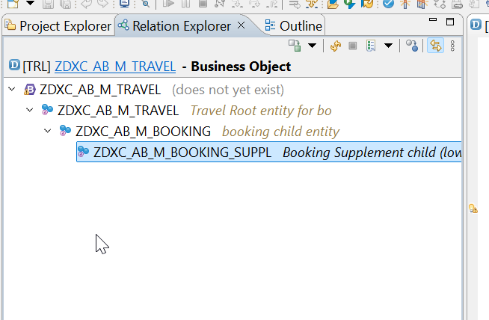
Business Object Definition
From structural point of view, a business object consists of a tree of entities (cds) that are linked in compositions. Every entity in this composition tree is an element that is modeled with CDS view entities. For our demo travel scenario we will implement 3 level composition tree.
/dmo/travel_m
(root entity)
1..N
Business Object
/dmo/booking_m
(child entity)
1..N
/dmo/bookingsuppl_m
(child entity)
www.anubhavtrainings.com

Slide 7

Development Flow – Processor and Approver
Fiori App – Processor
Create, update, delete, copy travel
Fiori App – Approver
Display the travel request data
Service definition
Service Binding
Service definition
Service Binding
MDE for Processor Projection
MDE for approver Projection
BDEF Projection
For Processor
Expose what is needed by a processor role in company
Behavior Definition (BDEF)
Tell RAP framework regarding our operations which needs to be supported for BO (managed)
BDEF Projection
For Approver
Expose what is needed by a approver role in company
Business Object Projection
For Processor
30 fields to internet
Business Object (definition)
Includes the Travel, Booking and Booking Supplement CDS entities
100 fields
Business Object Projection
For Approver
25 fields
www.anubhavtrainings.com

Slide 8
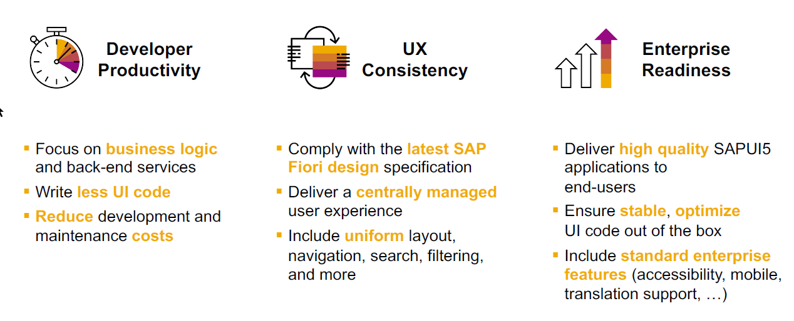
SAP Fiori elements boosts SAP Fiori development efficiency
www.anubhavtrainings.com

Slide 9
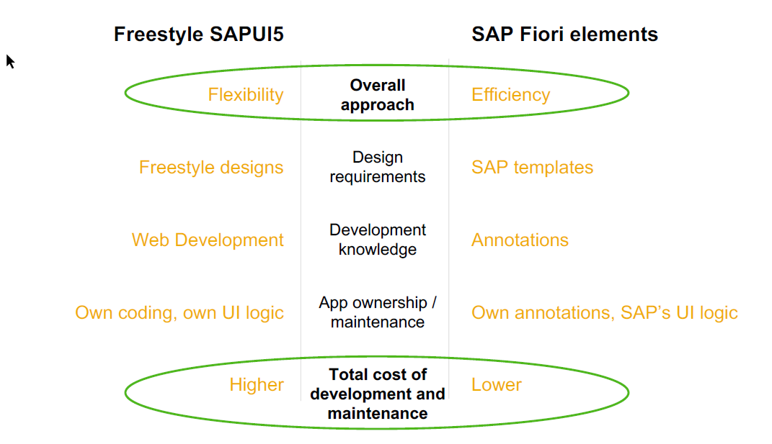
SAP Fiori elements prioritizes efficiency over flexibility
www.anubhavtrainings.com

Slide 10


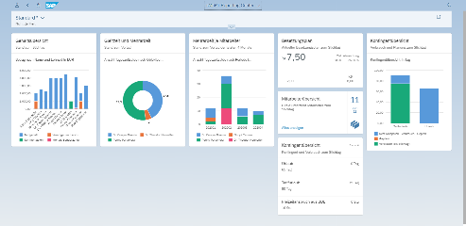





Developer Persona – Fiori Elements
Anubhav
Happy User
Rob
S/4HANA Technical consultant
ABAP Developer
Roxana
UX Designer | Fiori Developer
ABAP Dev. Tools
On
Eclipse
VS Code
BAS
OData Service
Fiori Elements Project
Annotations.xml
CDS Views
MDE
@
www.anubhavtrainings.com

Slide 11
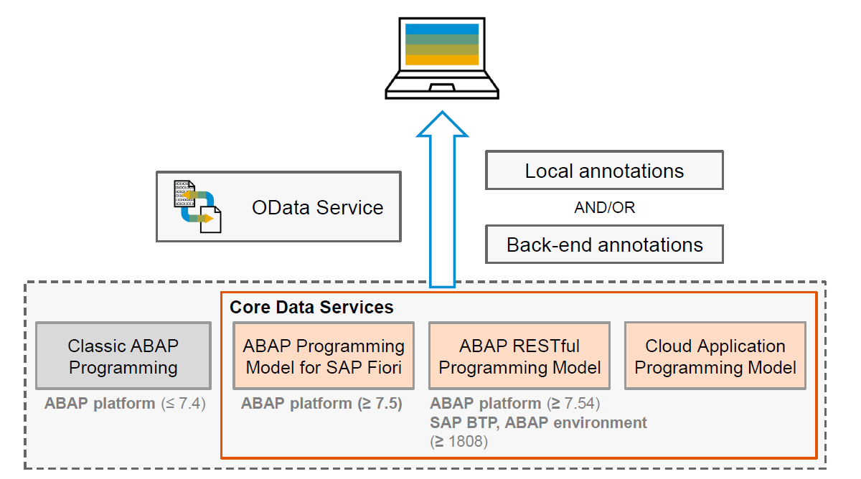
Big Picture – Architecture
www.anubhavtrainings.com

Slide 12

What We Did
Let’s Summarize

Slide 13

www.anubhavtrainings.com
Thank You
End of Day 15

Slide 14


We’re committed to empower you to be
#FutureReady
through powerful training solutions.
We build the workforce of the future.
260+
Corporate Clients
60,000+
Learners Trained
26000+
Learners Placed
FREE WEBINARS
Sign up for free webinars with industry experts every fortnight!
Enroll Now!
Contact us today!
https://anubhavtrainings.com

